Slide 1
SS ZG653 (RL 12.1) : Software Architecture Interactive Systems
Instructor: Prof. Santonu Sarkar

Slide 2
The Need: Example
You are going to build a web-based software application for this example
Grade A: 5
Grade B: 15
Grade C: 50
Grade D: 25
Grade F: 5
Grade | % of Students
A | 5
B | 15
C | 50
D | 25
F | 5
Such an application typically retrieves data and displays it for the user.
After the user changes the data, the system stores the updates in the data store.

Slide 3
Context and Problem
Context
Interactive application with flexible human-computer interface
Problem
Because the flow of information is between the data store and UI, one may be inclined to data and UI to reduce the amount of coding and to improve application performance.
However, the major problem is that UI tends to change much more frequently than the data storage system.
Another problem is that business applications tend to incorporate complex business logic which also gets mixed up

Slide 4
Forces
Same data with different presentation needed
Display, behavior and data-manipulation to be reflected immediately
UI is a different element altogether
Changes are very frequent, more than data and business logic
One should be able to test only the UI part
Skillset: HTML page designer skills are different from core app development. It is desirable to separate UI with the rest of the app
Changing look-feel (even device dependency) shouldn’t affect the core app
In web-app, one UI action can trigger many processing and then outcome may need to be collated into one

Slide 5
Model View Controller
Event
Event (keyboard, mouse) passed to the Controller
Multiple Controllers possible.
Each controller interprets input events and takes action
Controller
Controller
View
View
Multiple Views
Each view manages display of information
Model
Captures data
Sends data to View
Responds to Controller for changing data

Slide 6
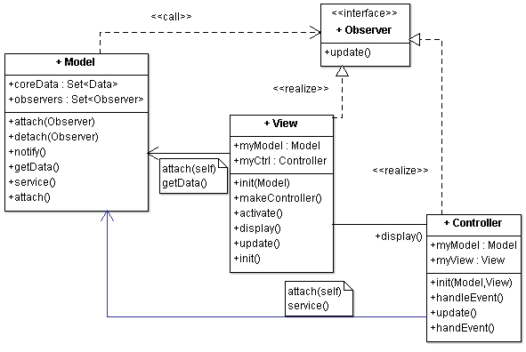
Model-View-Controller
User makes change in UI, which comes to controller
Controller interprets the change, informs model for the change
Model makes change in data
Model notifies all the relevant views regarding the change
View gets latest data and updates the display

Slide 7
Model-View-Controller
User makes change in UI, which comes to controller
Controller interprets the change, informs model for the change
Model makes change in data
Model notifies all the relevant views regarding the change
View gets latest data and updates the display

Slide 8
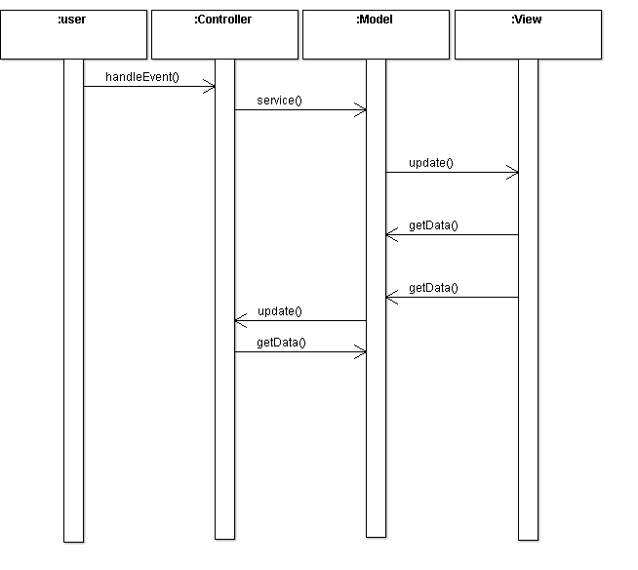
MVC Dynamics- User Event
notify()
display()

Slide 9
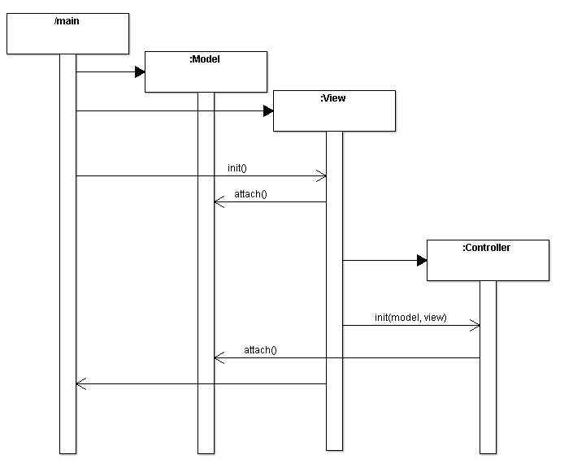
MVC Initialization
makeController()
startEventProcessing()

Slide 10
Other Dynamic Scenarios
Update to display alone i.e. no change in the controller
System exit. Sequence of deletion or destruction of objects
Scenario of update with multiple View-Controller pairs
…

Slide 11
MVC Implementation
RL 12.2

Slide 12
Implementation
 | # | Steps
Fundamental steps for realising a MVC | 1 | Separate human-computer interaction from the core functionality
 | 2 | Implement the set-up of MVC setup part
 | 3 | Design and implement Model
 | 4 | Design and implement views
 | 5 | Design and implement controllers

Slide 13
Initial Part
2. Set-up MVC
1: Separate Human-Computer Interaction
Analyze and separate the core functionality of your system and data from input and output
Decide on the functionality to be exposed to View(s) and controller(s)
Decide how many views and controllers you need
Write code that calls Model initialization method
Write code to call view creation
Write the Start the event processing mechanism

Slide 14
3: Design the Model
Encapsulate the data and functionality to access and modify data
Bridge to the core business logic of the system
Publish-Subscribe design pattern
Implement a registry that holds references of observers (Views and Controllers)
Provide APIs for an observer to subscribe and unsubscribe
Implement notify() which will be called every time the (other) parts of the system change the model’s state (and data)
In turn calls update() of each observer (a view or a controller)

Slide 15
4: Design and Implement Views
Design the appearance of the View(s)
Presents information to the user
Each important data entity should have a view
Each view may have its own controller (sometimes a set of views can also share a controller)
Creates a controller using the Factory Method design pattern (makeController() in View class)
View exposes a method for controller to use directly bypassing the model (a scenario when model’s state is not changed by the action of a user)
Implement update() method
retrieves data from the model and presents it on the screen
Initialization
Register with model
Set up relationship with the controller
Look for efficiency of fetching the data from model to build the view
View to decide based on changes if “Draw” needs to be called

Slide 16
5: Design and Implement Controllers
Initialization procedure
Binds the controller to it’s View and Model and enables event processing
Subscribes to the change-propagation mechanism
Set up relationship with the View
Implement event processing
accept user input as events; events delivery to the controller is platform dependent
Event translated into requests for the model or the associated view
Controller behavior dependent on state of model
Registers for change propagation
Implements its update() procedure

Slide 17
Variants
Document View
Document = Model
View = View Controller
Loose coupling of View and Controller enables multiple simultaneous and synchronized but different views of the same document

Slide 18
MVC in AJAX based Applications
RL 12.3

Slide 19
AJAX Based Web Applications
Traditional web based UI is thin-client based
Browser sends HTTP GET/POST request to the server
Entire web page is refreshed
Client side Javascript is used for field validations
One request may entail retrieving data from many servers
AJAX running on a browser
Makes asynchronous calls to the server without refreshing the primary HTML
No longer a thin client, provides a richer user interface

Slide 20
AJAX in Action
Rich UI
Largely Javascript and HTML
Since web server expects requests to come serially
Ajax controller serializes the request and then sends them
Can provide a rich user interface over browser
Many SaaS cloud applications make use of AJAX
AJAX is a perfect example of MVC pattern
AJAX controller
-- queues request
--calls response handlers
HTML+Javascript Code
REST call (JSON over HTTP)
HTTP server+Application server+Database
Returns JSON

Slide 21
AJAX and MVC
Controller
Some part is in the server (traditional Struts framework) and some part moves to the client as AJAX controller
It is possible to reflect the changes in the model immediately, unlike a traditional Web application
View is the HTML+Javascript
Model is the business logic that changes the underlying data
Model functions can change without impacting the UI or the controller
Rich Presentation Layer
Client side
Client side AJAX based Controller
REST call (JSON over HTTP)
Server side Controller
Business Logic
Server side
Data access Logic

Slide 22
Benefits
Multiple views of the same model
Synchronized views
‘Pluggable’ views and controllers
Exchangeability of ‘look-and-feel’
Framework potential

Slide 23
Liabilities
Increased complexity
Potential for excessive number of updates
Intimation connection between view and controller
Close coupling of views and controllers to a model
Inefficiency of data access in view
Difficulty of using MVC with modern user-interface tools

Slide 24
Thank You

